Slide 2
covariation principle - a given behavior is more likely to have been caused by the situation if that behavior covaries (or changes) across situations.

Slide 3
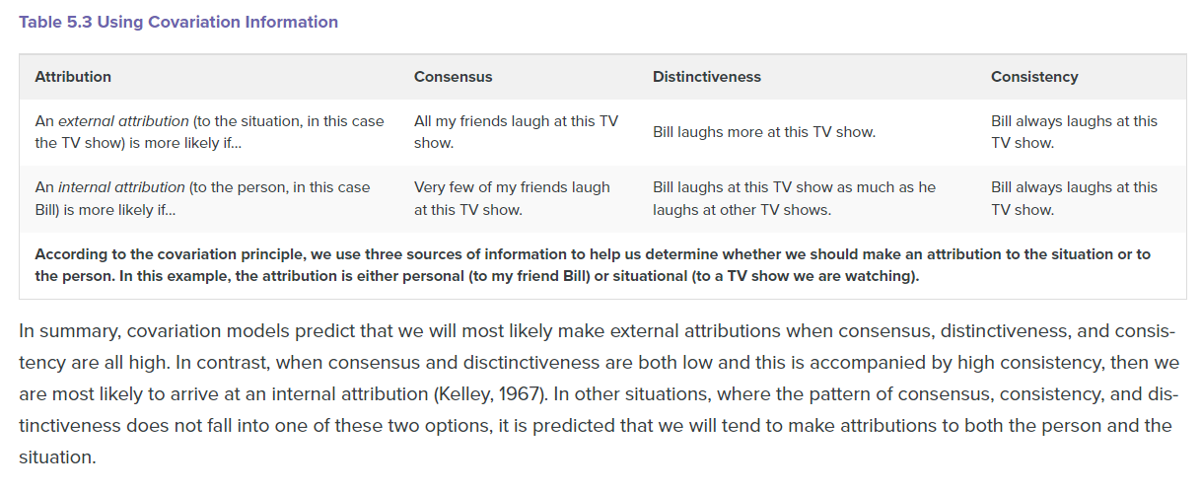

Slide 4
Consistency information. A situation seems to be the cause of a behavior if the situation always produces the behavior in the target. For instance, if I always start to cry at weddings, then it seems as if the wedding is the cause of my crying.
Distinctiveness information. A situation seems to be the cause of a behavior if the behavior occurs when the situation is present but not when it is not present. For instance, if I only cry at weddings but not at any other time, then it seems as if the wedding is the cause of my crying.
Consensus information. A situation seems to be the cause of a behavior if the situation creates the same behavior in most people. For instance, if many people cry at weddings, then it seems as if the wedding is the cause of my (and the other people’s) crying.

Slide 5
Consensus
Consensus is the co-variation of behavior across different people. If many people find Lisa attractive, consensus is high. If only Arnold finds Lisa attractive, consensus is low. High consensus is attributed to the stimulus (in the above example, to Lisa), while low consensus is attributed to the person (in this case, Arnold).
Distinctiveness
Distinctiveness refers to how unique the behavior is to the particular situation. There is a low distinctiveness if an individual behaves similarly in all situations, and there exists a high distinctiveness when the person only shows the behaviour in particular situations. If the distinctiveness is high, one will attribute this behaviour more to the circumstance instead of person (Gilovich et al., 2005).
Referring to the example of Dr. Stanton's complimenting Barry's work, if Dr. Stanton almost never compliments other people's work, he shows high distinctiveness. But if he compliments everybody's work, this is low distinctiveness, and one will attribute the behaviour to the person, in this case, Dr. Stanton (Orvis et al., 1975).
Consistency
Consistency is the covariation of behavior across time. If Jane is generous all the time, she shows high consistency. If Jane is rarely generous or is generous only at specific times, perhaps around the holidays, she shows low consistency. High consistency is attributed to the person (Jane is a generous person), while low consistency is attributed to the circumstance (the holidays make people generous).

Slide 6
Low Consensus, Low Distinctiveness, High Consistency = Personal Attribution High Consensus, High Distinctiveness, High Consistency = Stimulus Attribution High Consensus, Low Distinctiveness, Low Consistency = Circumstance Attribution
In reference to McArthur's study (1972), consider the following example: "John laughs at the comedian" This outcome could be caused by something in the person (John), the stimulus (the comedian) the circumstances (the comedy club on that night), or some combination of these factors (Hewstone et al., 1987).

Slide 7
If John is the only person laughing at the comedian (low consensus), he laughs at the comedian at other comedy clubs (high consistency), and he laughs at other comedians (low distinctiveness), then the effect is seen as caused by something in the person (John).
If everyone is laughing at the comedian (high consensus), John laughs at the comedian at other comedy clubs (high consistency), and he does not laugh at other comedians (high distinctiveness), then the effect is seen as caused by something in the stimulus (the comedian).
If everyone is laughing at the comedian (high consensus), John doesn't laugh at the comedian at other comedy clubs (low consistency), and he laughs at other comedians at the club (low distinctiveness) then the effect is seen as caused by something in the circumstance (the comedy club on that night).

